Slide 1


Powershell
“A .NET based scripting language designed for system administration and automation.”

Slide 2
Topics
Goals of this training
Introduction to Powershell
Datatypes & variables
Statements
Cmdlets vs Functions
Modules
Powershell and GIT
Getting started with basic scripting
Operators

Slide 3
Goals of this training
To get a better understanding of basic programming
1
To get familiar with how to use Powershell for scripting
2
To see how powerfull Powershell can be for automation
3

Slide 4
Requirements for this course
Download visual studio code (user install) on your device
Install the PowerShell extension
Install the Markdown Preview Enhanced VSCode extension (for .md files)
Download the course repository to your computer from: https://github.com/goldenplayer5630/Powershell-LearnIT, and open it in VSCode as a folder

Slide 5
Introduction to Powershell
Shell and scripting language
.NET
interpreted language (interpreted line by line)
System administration & Automation
Powershell 5 & 7
Powershell ISE vs Visual Studio Code
Notes:
Tell a bit about what powershell is. What .NET is, how it is used as an scripting and shell language, how it is compiled and the difference between 5 & 7.

Slide 6
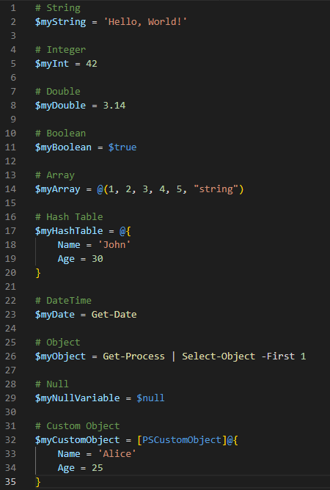
Datatypes & Variables
Variables store data in memory
String
Integer (int) & Double
Boolean
Array (or list)
Hash tables
Null
(Custom) Objects

Slide 7
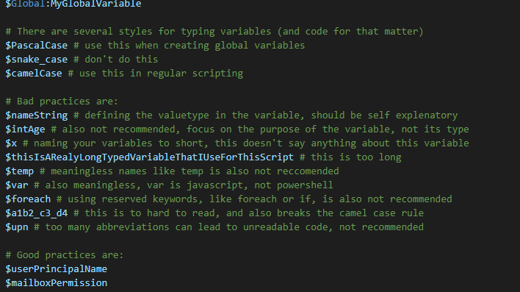
Variables

Slide 8
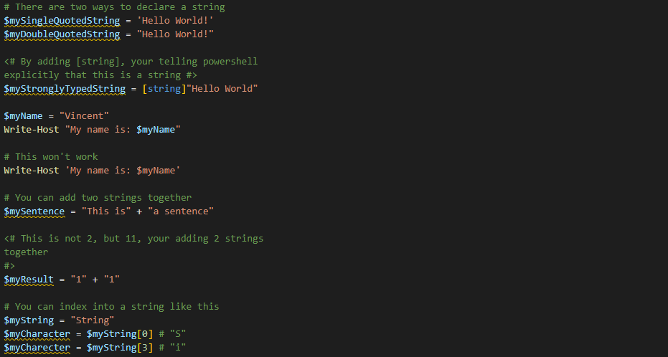
Strings

Slide 9
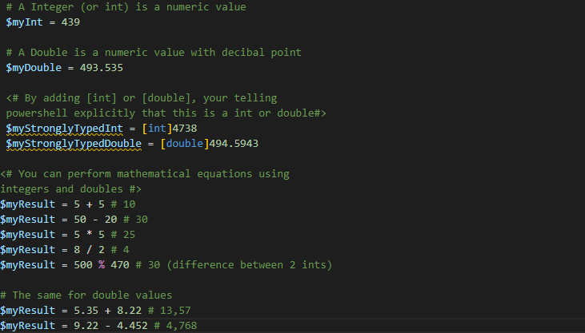
Integers & doubles

Slide 10
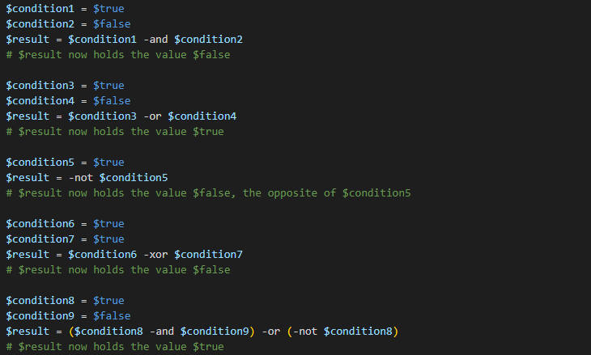
Booleans

Slide 11
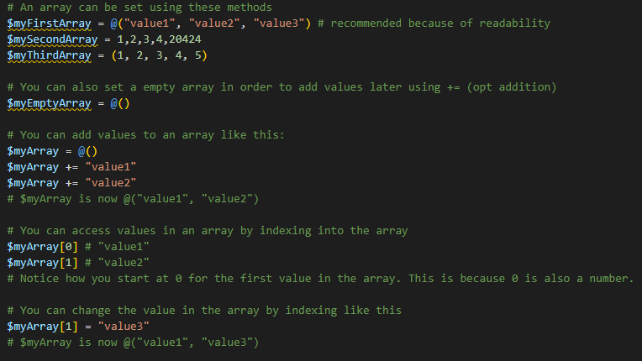
Arrays and indexing

Slide 12
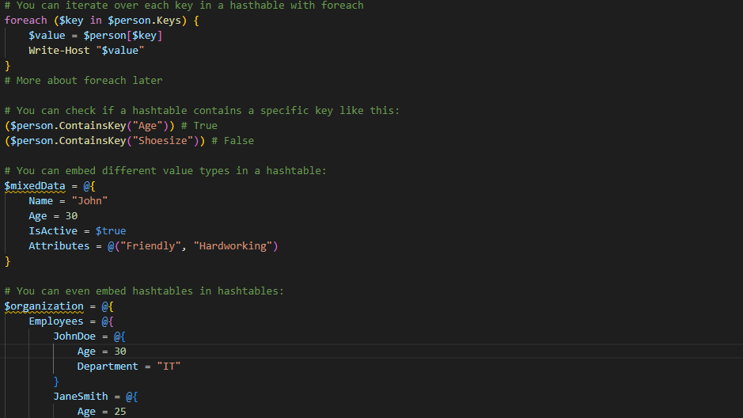
Hashtables

Slide 13
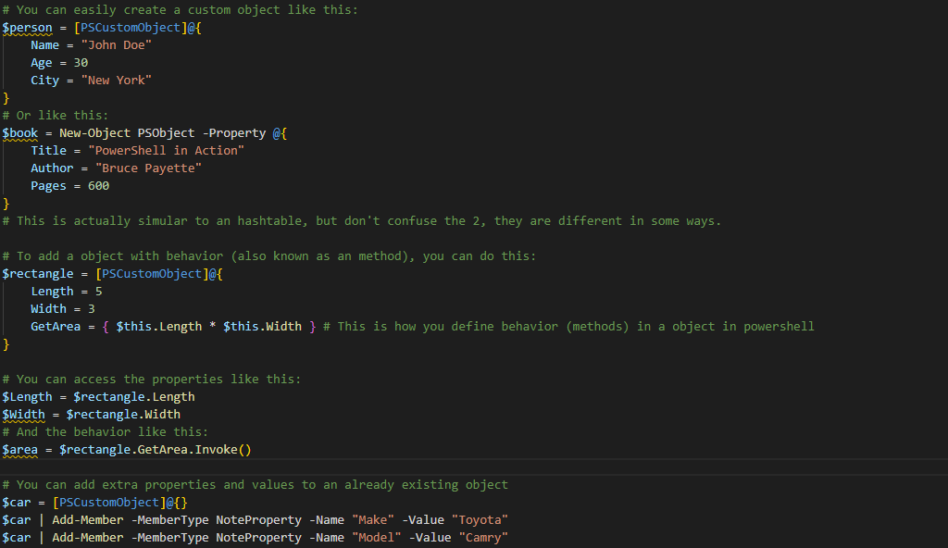
(Custom) Objects

Slide 14
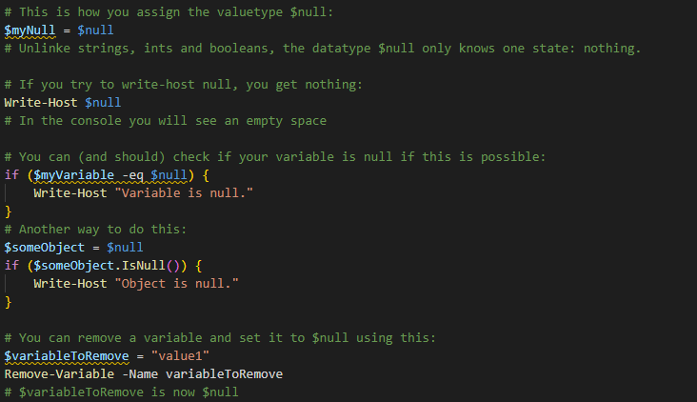
Null

Slide 15
Time for some assignments
Open a new PowerShell (.ps1) file / session
Open Pwsh_Datatype&Variables_Assignments.md for the assignments

Slide 16
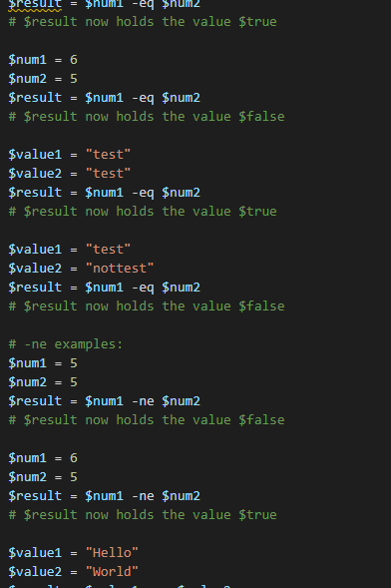
Operators
+ - * / % (Arithmetic operators)
= += -= *= /= %= (Assignment Operators)
++ -- (Unary Operators)
-eq –ne –gt –lt –ge –le (Equality Comparison Operators)
-and –or –not (!) –xor (Logical Operators)

Slide 17
Time for some more assignments
Open a new PowerShell (.ps1) file / session
Open Pwsh_Operator_Assignments.md for the assignments

Slide 18
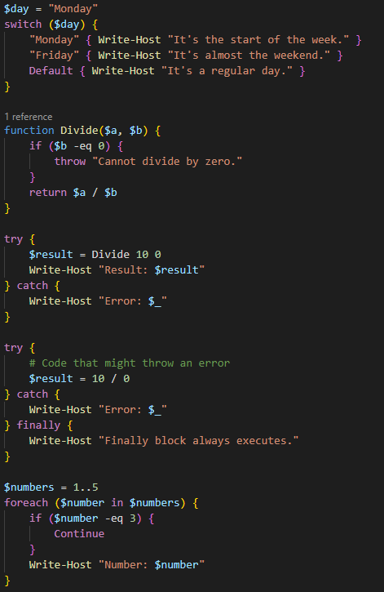
Statements
if, else, elseif & switch
for & foreach
while & do-while
break & continue
return, throw & exit
try, catch & finally

Slide 19
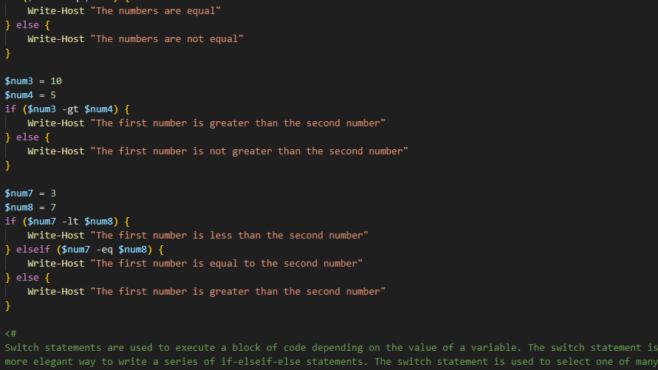
if, else, elseif & switch

Slide 20
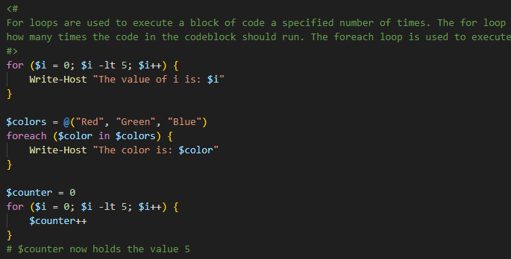
for & foreach

Slide 21
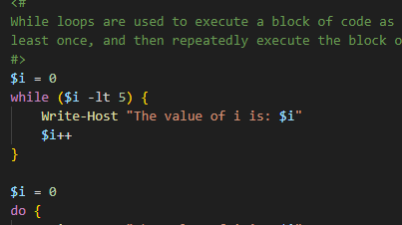
while & do-while

Slide 22
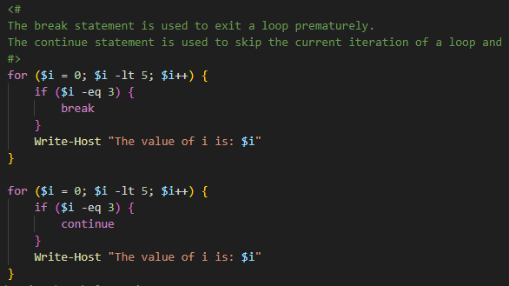
break & continue

Slide 23
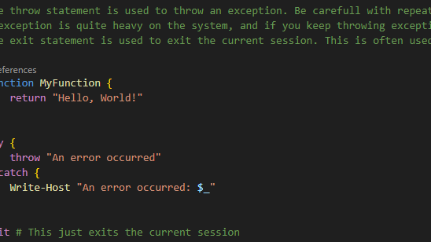
return, throw & exit

Slide 24
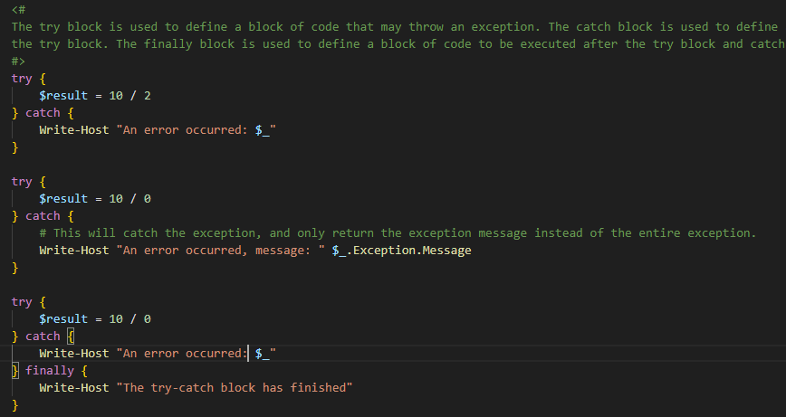
try, catch & finally

Slide 25
Even more assignments!
Open a new PowerShell (.ps1) file / session
Open Pwsh_Statements_Assignments.md for the assignments

Slide 26
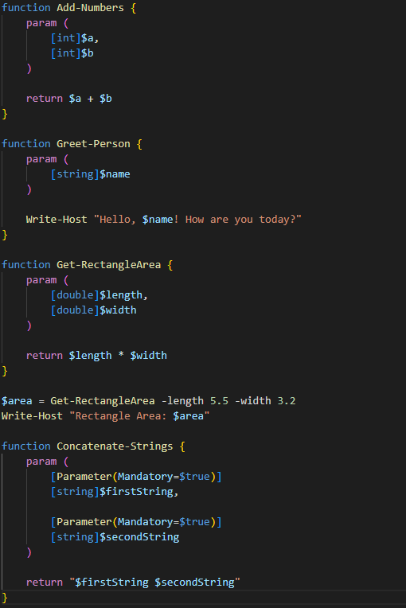
Cmdlets vs Functions
Functions
Cmdlets
Pipelines

Slide 27
Even, even more assignments!
Open a new PowerShell (.ps1) file / session
Open Pwsh_Functions_&_CmdLet_Assignments.md for the assignments

Slide 28
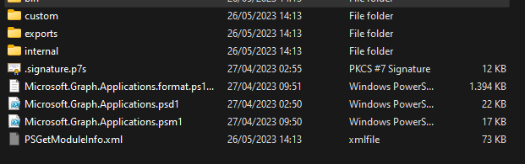
Modules
Package for additional code and functionality
Module Manifest (.pds1 file)
Module Code File (.psm1 file)
Modules can have functions and cmd-lets

Slide 29

Powershell and GIT
Repositories
GitLab vs GitHub
Git clients (GitHub desktop, Git Kraken, etc.)

Slide 30
Getting started with scripting
“With great power,
comes great responsibility”

